Slide 1
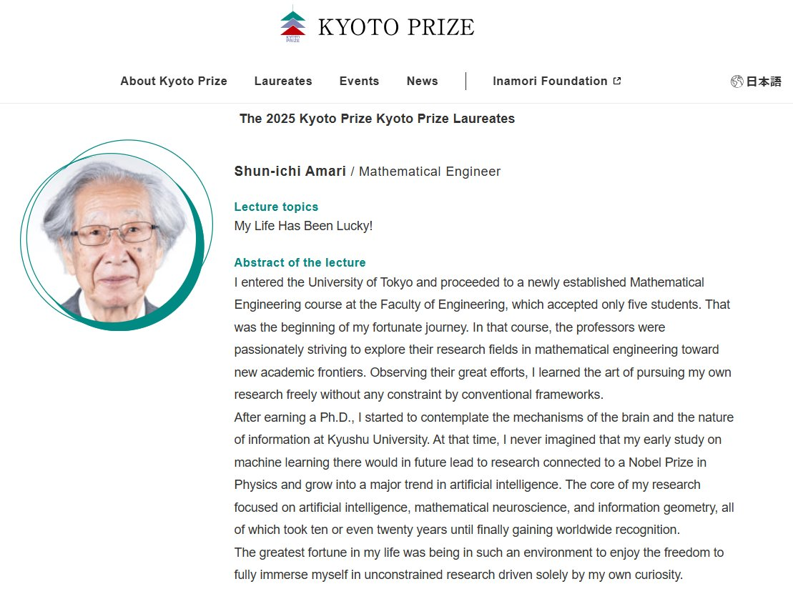
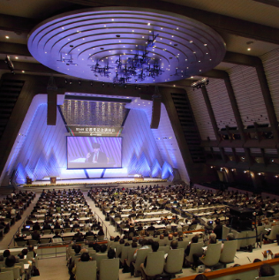
https://www.kyotoprize.org/en/lectures/2025

Slide 2
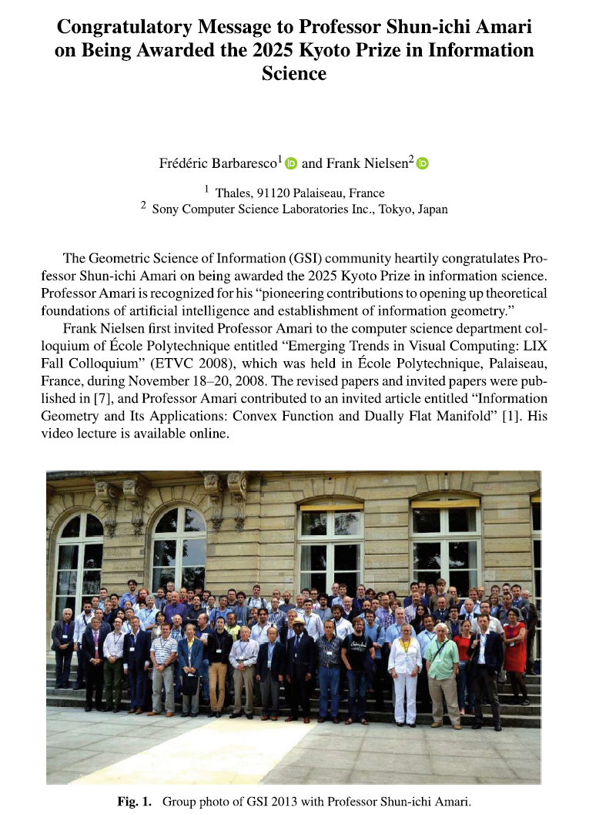


Slide 3


Slide 4
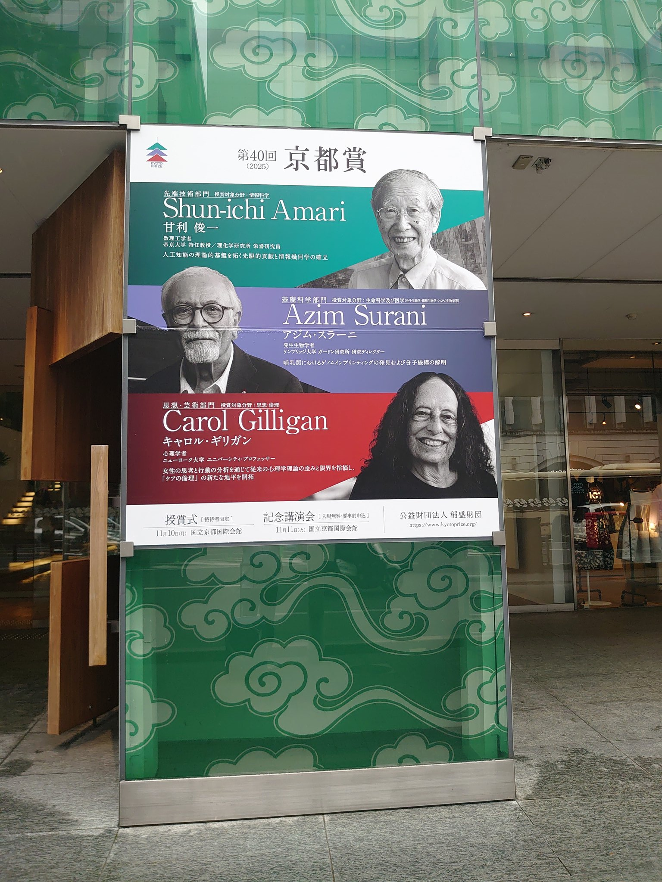
Downtown Kyoto city

Slide 5
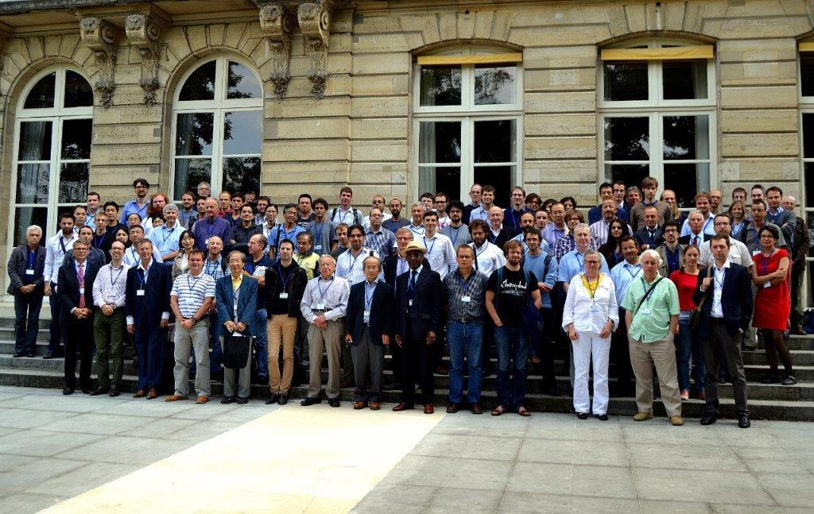
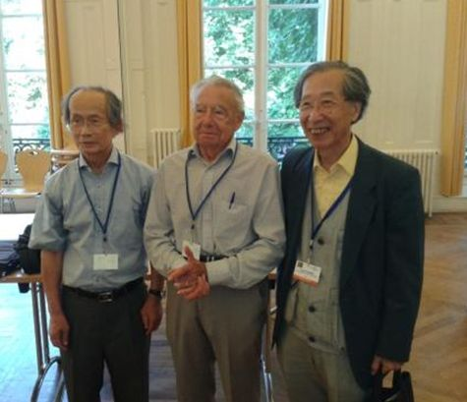
GSI’13 (Ecole des mines)

Slide 6
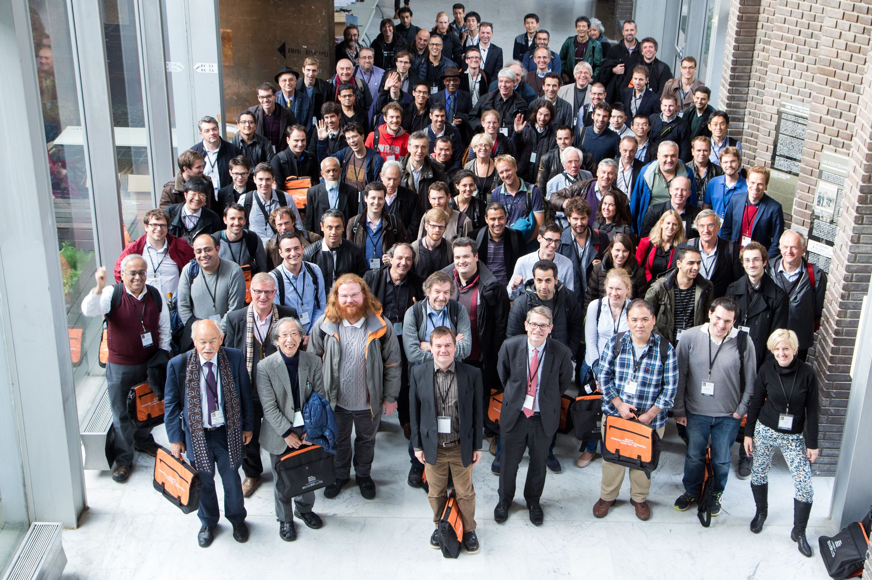
GSI’15 (Ecole Polytechnique)

Slide 7
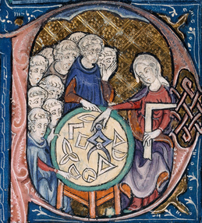

Shun-ichi Amari, Takeru Matsuda:
Wasserstein Statistics in One-Dimensional Location-Scale Models. GSI 2021: 499-506
Ryo Karakida, Shun-ichi Amari:
Information Geometry of Wasserstein Divergence. GSI 2017: 119-126
John Armstrong, Shun-ichi Amari:
The Pontryagin Forms of Hessian Manifolds. GSI 2015: 240-247
Shun-ichi Amari, Nihat Ay:
Standard Divergence in Manifold of Dual Affine Connections. GSI 2015: 320-325
Shun-ichi Amari:
Information Geometry and Its Applications: Survey. GSI 2013: 3
But also keynote talk at ETVC 2008@Ecole Polytechnique

Slide 8


https://link.springer.com/book/10.1007/978-3-032-03918-7
https://link.springer.com/book/10.1007/978-3-032-03921-7
https://link.springer.com/book/10.1007/978-3-032-03924-8
Notes:
https://link.springer.com/book/10.1007/978-3-032-03918-7
https://link.springer.com/book/10.1007/978-3-032-03921-7
https://link.springer.com/book/10.1007/978-3-032-03924-8

